Slide 1
CSE 205: Digital Logic Design
Prepared By
Dr. Tanzima Hashem,
Assistant Professor, CSE, BUET
(Updated By
Fatema Tuz Zohora
Lecturer, CSE, BUET)

Slide 2
Logic Circuits
Logic Circuits: Combinational and Sequential
Combinational Circuits
A combinational circuit consists of logic gates whose outputs at any time are determined from only the present combination of inputs.
Sequential Circuits
A sequential circuits employ storage elements and logic gates.
The outputs are a function of the inputs and the state of the storage elements.
The state of the storage elements, in turn, is a function of the previous inputs (and the previous state).
Notes:
My note::: remember the alarm & the sprinkler

Slide 3
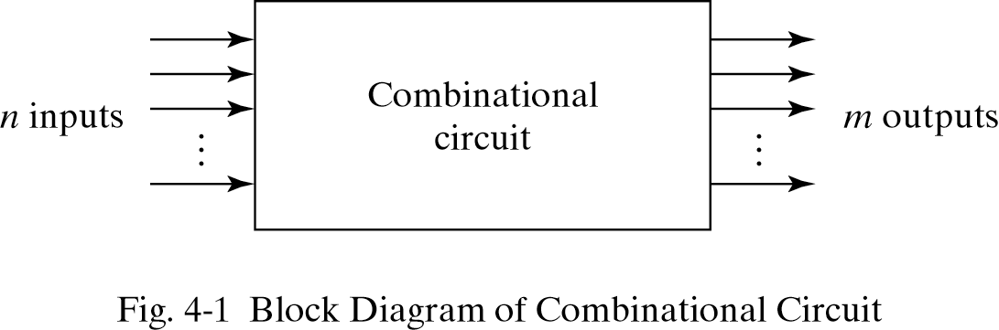
Combinational Circuits
The n input binary variables come from an external source.
The m output variables are produced by the internal combinational logic circuit and go to an external destination.

Slide 4
Combinational Circuits
Analysis
Given a circuit, find out its function
Function may be expressed as:
Boolean function
Truth table
Design
Given a desired function, determine its circuit
Function may be expressed as:
Boolean function
Truth table
?
?
?

Slide 5
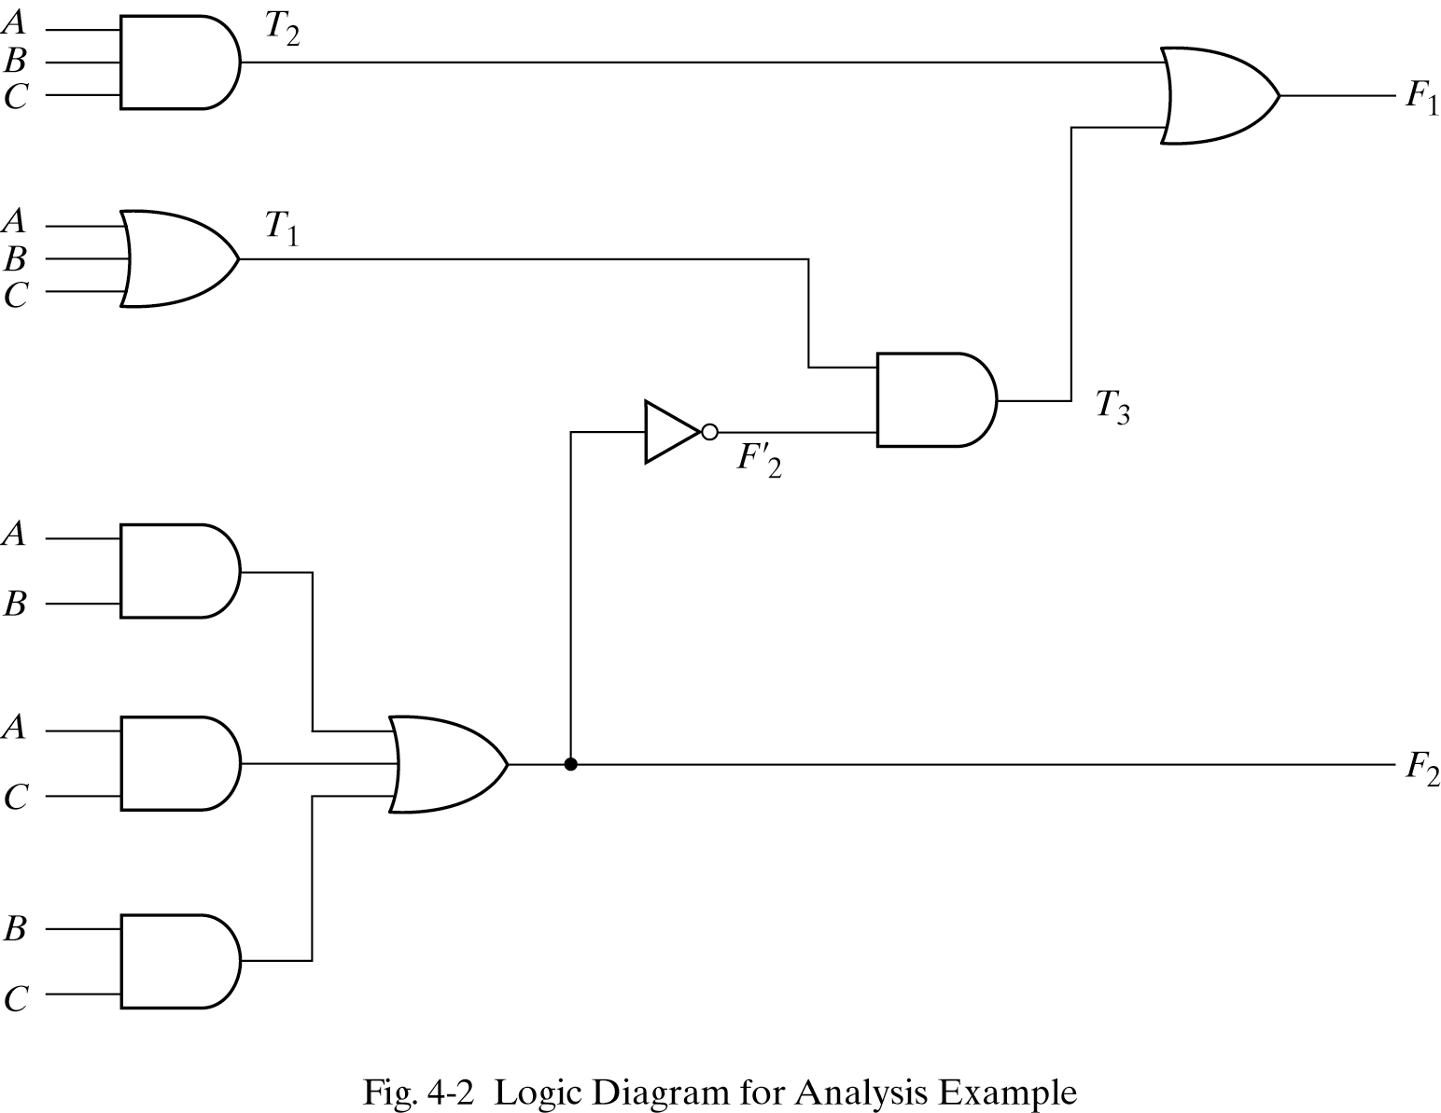
Analysis Procedure Boolean Expression Approach
F₂ = AB + AC + BC
T₁ = A + B + C
T₂ = ABC
T₃ = F₂´ T₁
F₁ = T₃ + T₂
Or
F₁ = A´BC´ + A´B´C + AB´C´ + ABC

Slide 6
Analysis Procedure Truth Table Approach
A
0
0
0
0
1
1
1
1
B
0
0
1
1
0
0
1
1
C
0
1
0
1
0
1
0
1
F₂
0
0
0
1
0
1
1
1
F₂ ´
1
1
1
0
1
0
0
0
T₁
0
1
1
1
1
1
1
1
T₂
0
0
0
0
0
0
0
1
T₃
0
1
1
0
1
0
0
0
F₁
0
1
1
0
1
0
0
1

Slide 7
Design Procedure
Given a problem statement:
Determine the number of inputs and outputs
Derive the truth table
Simplify the Boolean expression for each output
Produce the required circuit and verify it
Example:
Design a circuit to convert a “BCD” code to “Excess 3” code
4-bits
0-9 values
?
4-bits
Value+3

Slide 8
Design Procedure BCD-to-Excess 3 Converter
 |  |  |  | C
 |  |  | 1 | 1 | 1 | B
A |  | x | x | x | x
 |  | 1 | 1 | x | x
 |  |  | D
 |  |  |  | C
 |  |  | 1 | 1 | 1
 |  | 1 |  |  |  | B
A |  | x | x | x | x
 |  |  | 1 | x | x
 |  |  | D
A B C D | w x y z
0 0 0 0 | 0 0 1 1
0 0 0 1 | 0 1 0 0
0 0 1 0 | 0 1 0 1
0 0 1 1 | 0 1 1 0
0 1 0 0 | 0 1 1 1
0 1 0 1 | 1 0 0 0
0 1 1 0 | 1 0 0 1
0 1 1 1 | 1 0 1 0
1 0 0 0 | 1 0 1 1
1 0 0 1 | 1 1 0 0
1 0 1 0 | x x x x
1 0 1 1 | x x x x
1 1 0 0 | x x x x
1 1 0 1 | x x x x
1 1 1 0 | x x x x
1 1 1 1 | x x x x
w = A+BC+BD
x = B’C+B’D+BC’D’
 |  |  |  | C
 |  | 1 |  | 1
 |  | 1 |  | 1 |  | B
A |  | x | x | x | x
 |  | 1 |  | x | x
 |  |  | D
 |  |  |  | C
 |  | 1 |  |  | 1
 |  | 1 |  |  | 1 | B
A |  | x | x | x | x
 |  | 1 |  | x | x
 |  |  | D
y = C’D’+CD
z = D’

Slide 9
Design Procedure BCD-to-Excess 3 Converter
A B C D | w x y z
0 0 0 0 | 0 0 1 1
0 0 0 1 | 0 1 0 0
0 0 1 0 | 0 1 0 1
0 0 1 1 | 0 1 1 0
0 1 0 0 | 0 1 1 1
0 1 0 1 | 1 0 0 0
0 1 1 0 | 1 0 0 1
0 1 1 1 | 1 0 1 0
1 0 0 0 | 1 0 1 1
1 0 0 1 | 1 1 0 0
1 0 1 0 | x x x x
1 0 1 1 | x x x x
1 1 0 0 | x x x x
1 1 0 1 | x x x x
1 1 1 0 | x x x x
1 1 1 1 | x x x x
w = A + B(C+D)
y = (C+D)’ + CD
x = B’(C+D) + B(C+D)’
z = D’

Slide 10
Decoders
A decoder is a combinational circuit that converts binary information from n input lines to an 2^{n} unique output lines.
1-to-2-Line Decoder

Slide 11
Decoders
Only one lamp will turn on
Extract “Information” from the code
Binary Decoder
Example: 2-bit Binary Number
0
1
2
3
Binary Decoder
1
0
0
0
x₁
x₀
0
0

Slide 12
Decoders
2-to-4 Line Decoder
Binary Decoder
Y₃
Y₂
Y₁
Y₀
I₁
I₀
I₁ I₀ | Y₃ Y₂ Y₁ Y₀
0 0 | 0 0 0 1
0 1 | 0 0 1 0
1 0 | 0 1 0 0
1 1 | 1 0 0 0
Notes:
My note::: Binary decoder mainly uses the minters of sop

Slide 13
Decoders
3-to-8 Line Decoder
Binary Decoder
Y₇
Y₆
Y₅
Y₄ Y₃
Y₂
Y₁
Y₀
I₂
I₁
I₀

Slide 14
Decoders
“Enable” Control
Binary Decoder
Y₃
Y₂
Y₁
Y₀
I₁
I₀
E
E | I₁ I₀ | Y₃ Y₂ Y₁ Y₀
0 | x x | 0 0 0 0
1 | 0 0 | 0 0 0 1
1 | 0 1 | 0 0 1 0
1 | 1 0 | 0 1 0 0
1 | 1 1 | 1 0 0 0

Slide 15
Decoders
Active-High / Active-Low
I₁ I₀ | Y₃ Y₂ Y₁ Y₀
0 0 | 0 0 0 1
0 1 | 0 0 1 0
1 0 | 0 1 0 0
1 1 | 1 0 0 0
I₁ I₀ | Y₃ Y₂ Y₁ Y₀
0 0 | 1 1 1 0
0 1 | 1 1 0 1
1 0 | 1 0 1 1
1 1 | 0 1 1 1
Binary Decoder
Binary Decoder
Y₃
Y₂
Y₁
Y₀
Y₃
Y₂
Y₁
Y₀
I₁
I₀
I₁
I₀
Notes:
My note:: we simply use active high

Slide 16
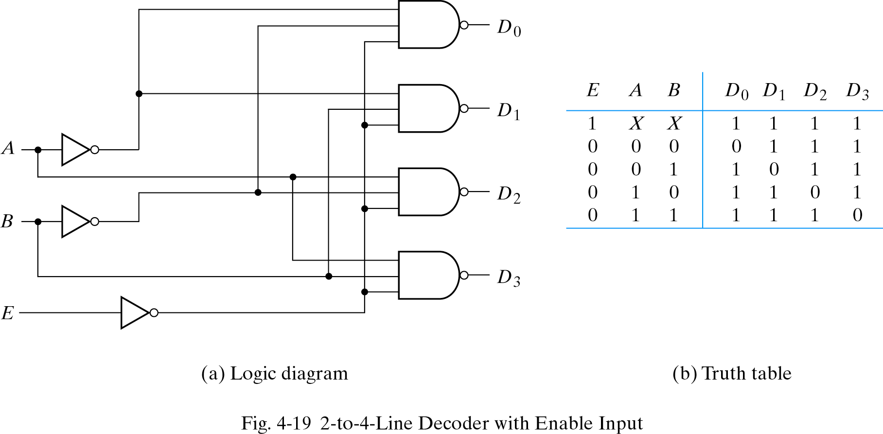
Decoders

Slide 17
Decoders
I₂ I₁ I₀
Expansion
I₂ I₁ I₀ | Y₇ Y₆ Y₅ Y₄ Y₃ Y₂ Y₁ Y₀
0 0 0 | 0 0 0 0 0 0 0 1
0 0 1 | 0 0 0 0 0 0 1 0
0 1 0 | 0 0 0 0 0 1 0 0
0 1 1 | 0 0 0 0 1 0 0 0
1 0 0 | 0 0 0 1 0 0 0 0
1 0 1 | 0 0 1 0 0 0 0 0
1 1 0 | 0 1 0 0 0 0 0 0
1 1 1 | 1 0 0 0 0 0 0 0
Binary Decoder
Y₃
Y₂
Y₁
Y₀
Y₇
Y₆
Y₅
Y₄
Y₃
Y₂
Y₁
Y₀
I₀
I₁
E
Binary Decoder
Y₃
Y₂
Y₁
Y₀
I₀
I₁
E

Slide 18
Implementation Using Decoders
Binary Decoder
Each output is a minterm
All minterms are produced
Sum the required minterms
Example: Full Adder
S(x, y, z) = ∑(1, 2, 4, 7)
C(x, y, z) = ∑(3, 5, 6, 7)
Y₇
Y₆
Y₅
Y₄ Y₃
Y₂
Y₁
Y₀
x
y
z
I₂
I₁
I₀
S C

Slide 19
Encoders
Does reverse operation to decoder
An encoder has 2^{n} (or fewer) input lines and n output lines
Constraint – only one input is active at a time

Slide 20
Encoders
Binary Encoder
I₇
I₆
I₅
I₄ I₃
I₂
I₁
I₀
Octal-to-Binary Encoder (8-to-3)
I₇ I₆ I₅ I₄ I₃ I₂ I₁ I₀ | Y₂ Y₁ Y₀
0 0 0 0 0 0 0 1 | 0 0 0
0 0 0 0 0 0 1 0 | 0 0 1
0 0 0 0 0 1 0 0 | 0 1 0
0 0 0 0 1 0 0 0 | 0 1 1
0 0 0 1 0 0 0 0 | 1 0 0
0 0 1 0 0 0 0 0 | 1 0 1
0 1 0 0 0 0 0 0 | 1 1 0
1 0 0 0 0 0 0 0 | 1 1 1
Y₂
Y₁
Y₀
Notes:
My note:: encoder is in sum of maxterms

Slide 21
Priority Encoders
Encoder with priority function
Multiple inputs may be true simultaneously
Higher priority input gets the precedence

Slide 22
Priority Encoders
Priority Encoder
I₃
I₂
I₁
I₀
4-Input Priority Encoder
V
Y₁
Y₀
I₃ I₂ I₁ I₀ | Y₁ Y₀ | V
0 0 0 0 | x x | 0
0 0 0 1 | 0 0 | 1
0 0 1 x | 0 1 | 1
0 1 x x | 1 0 | 1
1 x x x | 1 1 | 1

Slide 23
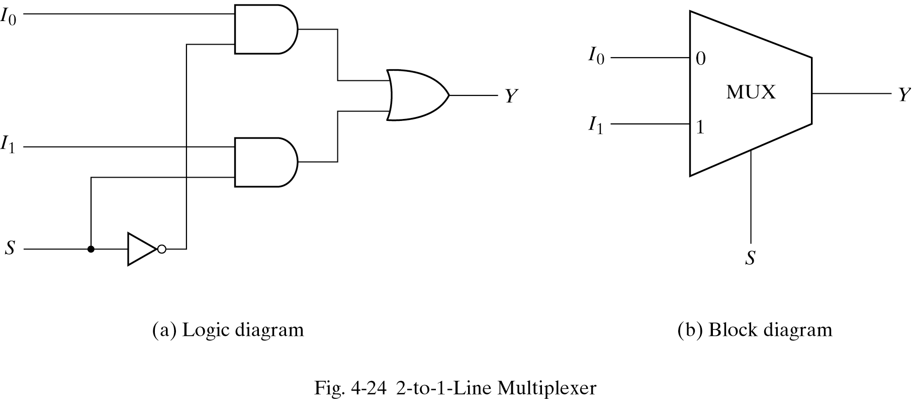
Multiplexers
A multiplexer is a combinational circuit that selects one of many input lines (2^{n}) and directs it to its single output line.
There are n selection lines whose bit combinations determine which input is selected.

Slide 24
Multiplexers
4-to-1 MUX
MUX
I₀
I₁
I₂
I₃
Y
S₁ S₀
S₁ S₀ | Y
0 0 | I₀
0 1 | I₁
1 0 | I₂
1 1 | I₃

Slide 25
Function Implementation using MUX
(n+1) variable function can be implemented with 2^{n} x 1 MUX
Simplify the function in sum of minterms form
Among (n+1) variables, n variables are used as selector and one variable is connected with input lines
f(A, B, C, D, E, …..)
Input
Selectors

Slide 26
Procedure 1

Slide 27
Implementation Using Multiplexers: Procedure 1
F(A, B, C) = ∑(1, 3, 5, 6)
Steps:
Choose the selector variables. Lets choose,
B, C as selector S₁ and S₀
A as input line
In the first row, list the name of the input lines of the multiplexers horizontally
In the second row, list the minterms where A is complemented
In the third row, list the minterms where A is uncomplemented

Slide 28
Implementation Using Multiplexers: Procedure 1
F(A, B, C) = ∑(1, 3, 5, 6)
Steps:
Circle the minterms for which the function outputs 1
Fourth row presents the multiplexer inputs
If the two minterms in a column are not circled, apply 0 to the corresponding multiplexer input
If the two minterms in a column are circled, apply 1 to the corresponding multiplexer input
If the bottom minterm is circled and the top is not circled, apply A to the corresponding multiplexer input
If the top minterm is circled and the bottom is not circled, apply A’ to the corresponding multiplexer input

Slide 29
Implementation Using Multiplexers: Procedure 1
F(A, B, C) = ∑(1, 3, 5, 6)
4x1 MUX
MUX input line | I₀ | I₁ | I₂ | I₃
A’ | 0 | 1 | 2 | 3
A | 4 | 5 | 6 | 7
Input values | 0 | 1 | A | A’
0
I₀
I₁
I₂
I₃
1
S₁ S₀
A B C

Slide 30
Implementation Using Multiplexers: Procedure 1
F(A, B, C) = ∑(1, 3, 5, 6)
What if A, B are the selectors and C goes to input line?
4x1 MUX
MUX input line | I₀ | I₁ | I₂ | I₃
C’ | 0 | 2 | 3 | 6
C | 1 | 3 | 5 | 7
Input values | C | C | C | C’
I₀
I₁
I₂
I₃
S₁ S₀
C A B

Slide 31
Procedure 2

Slide 32
Implementation Using Multiplexers: Procedure 2
Steps:
Complete the truth table from the SOP.
The first n – 1 variables in the table are applied to the selection inputs of the multiplexer.
For each combination of the selection variables, we evaluate the output as a function of the last variable.
Apply these values to the data input in proper order.

Slide 33
Implementation Using Multiplexers: Procedure 2
Example F(x, y) = ∑(0, 1, 3)
x y | F
0 0 | 1
0 1 | 1
1 0 | 0
1 1 | 1
MUX
1
1
0
1
I₀
I₁
I₂
I₃
Y
F
S₁ S₀
x y

Slide 34
Implementation Using Multiplexers: Procedure 2
Example F(x, y, z) = ∑(1, 2, 6, 7)
x y z | F
0 0 0 | 0
0 0 1 | 1
0 1 0 | 1
0 1 1 | 0
1 0 0 | 0
1 0 1 | 0
1 1 0 | 1
1 1 1 | 1
MUX
0
1
1
0
0
0
1
1
I₀
I₁
I₂
I₃ I₄
I₅
I₆
I₇
Y
F
S₂ S₁ S₀
x y z

Slide 35
Implementation Using Multiplexers: Procedure 2
F(x, y, z) = ∑(1, 2, 6, 7)
x y z | F
0 0 0 | 0
0 0 1 | 1
0 1 0 | 1
0 1 1 | 0
1 0 0 | 0
1 0 1 | 0
1 1 0 | 1
1 1 1 | 1
z
MUX
I₀
I₁
I₂
I₃
F = z
F
z
0
Y
F = z
1
S₁ S₀
F = 0
x y
F = 1

Slide 36
Implementation Using Multiplexers: Procedure 2
F(A, B, C, D) = ∑(1, 3, 4, 11, 12, 13, 14, 15)
A B C D | F
0 0 0 0 | 0
0 0 0 1 | 1
0 0 1 0 | 0
0 0 1 1 | 1
0 1 0 0 | 1
0 1 0 1 | 0
0 1 1 0 | 0
0 1 1 1 | 0
1 0 0 0 | 0
1 0 0 1 | 0
1 0 1 0 | 0
1 0 1 1 | 1
1 1 0 0 | 1
1 1 0 1 | 1
1 1 1 0 | 1
1 1 1 1 | 1
MUX
D
I₀
I₁
I₂
I₃ I₄
I₅
I₆
I₇
F = D
D
F = D
D
F = D
0
Y
F
0
F = 0
D
F = 0
1
F = D
1
S₂ S₁ S₀
F = 1
F = 1
A B C

Slide 37
Procedure 1 vs procedure 2
Among the function variables, if the first or some middle variable other than the last one is to be used in input line then procedure 1 is preferable.

Slide 38
Multiplexer Expansion 4-to-1 MUX using 2-to-1 MUX
I₀
I₁
S₁ | S₀ | Y
0 | 0 | I₀
0 | 1 | I₁
1 | 0 | I₂
1 | 1 | I₃
0
1
Y
I₂
I₃
S₁ S₀

Slide 39
Multiplexer Expansion 4-to-1 MUX using 2-to-1 MUX
I₀
I₁
S₁ | S₀ | Y
0 | 0 | I₀
0 | 1 | I₁
1 | 0 | I₂
1 | 1 | I₃
0
1
Y
I₂
I₃
S₁ S₀

Slide 40
Multiplexer Expansion 4-to-1 MUX using 2-to-1 MUX
I₀
I₁
S₁ | S₀ | Y
0 | 0 | I₀
0 | 1 | I₁
1 | 0 | I₂
1 | 1 | I₃
0
1
Y
I₂
I₃
S₁ S₀

Slide 41
Multiplexer Expansion 4-to-1 MUX using 2-to-1 MUX
I₀
I₁
S₁ | S₀ | Y
0 | 0 | I₀
0 | 1 | I₁
1 | 0 | I₂
1 | 1 | I₃
0
1
Y
I₂
I₃
S₁ S₀

Slide 42
Multiplexer Expansion 4-to-1 MUX using 2-to-1 MUX
I₀
I₁
S₁ | S₀ | Y
0 | 0 | I₀
0 | 1 | I₁
1 | 0 | I₂
1 | 1 | I₃
0
1
Y
I₂
I₃
S₁ S₀

Slide 43
Multiplexer Expansion 8-to-1 MUX using Dual 4-to-1 MUX
MUX
I₀
I₁
I₂
I₃
I₄
I₅
I₆
I₇
I₀
I₁
I₂
I₃
Y
S₁ S₀
MUX
I₀
I₁
Y
Y
MUX
S
I₀
I₁
I₂
I₃
Y
S₁ S₀
1
0 0
S₂ S₁ S₀

Slide 44
Multiplexers
Quad 2-to-1 MUX: Four 2x1 MUX can be used simultaneously
A₃
A₂
A₁
A₀
MUX
I₀
I₁
B₃
B₂
B₁
B₀
Y
S
MUX
A₃
A₂
A₁
A₀
MUX
Y₃
Y₂
Y₁
Y₀
I₀
I₁
Y
S
B₃
B₂
B₁
B₀
MUX
I₀
I₁
Y
S
S E
MUX
I₀
I₁
Y
S
S

Slide 45
Multiplexers
Quad 2-to-1 MUX
A₃
A₂
A₁
A₀
MUX
I₀
I₁
B₃
B₂
B₁
B₀
Y
S
MUX
I₀
I₁
Y
S
MUX
I₀
I₁
Y
S
MUX
I₀
I₁
Y
S
S
Active High Enable: The output is enabled when E=0
_{E}

Slide 46
Multiplexers
Quad 2-to-1 MUX
A₃
A₂
A₁
A₀
MUX
I₀
I₁
B₃
B₂
B₁
B₀
Y
S
MUX
I₀
I₁
Y
S
MUX
I₀
I₁
Y
S
MUX
I₀
I₁
Y
S
S
_{E}
Active Low Enable: The output is enabled when E=0

Slide 47
DeMultiplexers
A circuit receives information from a single line and directs it to one of 2^{n} possible output lines.
DeMUX
S₁ S₀ | Y₃ Y₂ Y₁ Y₀
0 0 | 0 0 0 I
0 1 | 0 0 I 0
1 0 | 0 I 0 0
1 1 | I 0 0 0
Y₃
Y₂
Y₁
Y₀
I
S₁ S₀

Slide 48
DeMultiplexers / Decoders
A decoder with enable input can function as a demultiplexer
Binary Decoder
Y₃
Y₂
Y₁
Y₀
I₁
I₀
E
E | I₁ I₀ | Y₃ Y₂ Y₁ Y₀
0 | x x | 0 0 0 0
1 | 0 0 | 0 0 0 1
1 | 0 1 | 0 0 1 0
1 | 1 0 | 0 1 0 0
1 | 1 1 | 1 0 0 0

Slide 49
Demultiplexers
DeMUX
Y₃
Y₂
Y₁
Y₀
I
S₁ S₀
I | S₁ S₀ | Y₃ Y₂ Y₁ Y₀
0 | x x | 0 0 0 0
1 | 0 0 | 0 0 0 1
1 | 0 1 | 0 0 1 0
1 | 1 0 | 0 1 0 0
1 | 1 1 | 1 0 0 0
S₁
S₀
I

Slide 50
Three-State Gates
Z=impedance
Tri-State Buffer
Tri-State Inverter
C A | Y
0 x | Hi-Z
1 0 | 0
1 1 | 1
A
Y
C
A
Y
C

Slide 51
Three-State Gates 2-to-1-line mux
C | Y
0 | I₀
1 | I₁
I₀
Y
I₁
C (Selector)

Slide 52
Three-State Gates 4-to-1-line mux
I₃
E | S₁ S₀ | Y
0 | x x | 0
1 | 0 0 | I₀
1 | 0 1 | I₁
1 | 1 0 | I₂
1 | 1 1 | I₃
I₂
INPUTS
Y
I₁
I₀
Binary Decoder
Y₃
Y₂
Y₁
Y₀
S₁
I₁
I₀
E
Selectors
S₀
E

Slide 53
Binary Adder
The most basic arithmetic operation is the addition of two binary digits.
A combination circuit that performs the addition of two bits is half adder
A adder performs the addition of 2 significant bits and a previous carry is called a full adder

Slide 54
Binary Adder
Half Adder
Adds 1-bit plus 1-bit
Produces Sum and Carry
x
y
S
C
HA
x
+ y
───
C S
x y | C S
0 0 | 0 0
0 1 | 0 1
1 0 | 0 1
1 1 | 1 0
x
y
S
C

Slide 55
Binary Adder
x
y
z
S
C
FA
Full Adder
Adds 1-bit plus 1-bit plus 1-bit
Produces Sum and Carry
x
+ y
+ z
───
C S
x y z | C S
0 0 0 | 0 0
0 0 1 | 0 1
0 1 0 | 0 1
0 1 1 | 1 0
1 0 0 | 0 1
1 0 1 | 1 0
1 1 0 | 1 0
1 1 1 | 1 1
 |  |  |  | y
 |  | 0 | 1 | 0 | 1
x |  | 1 | 0 | 1 | 0
 |  |  | z
S = xy'z'+x'yz'+x'y'z+xyz = x ⊕ y ⊕ z
 |  |  |  | y
 |  | 0 | 0 | 1 | 0
x |  | 0 | 1 | 1 | 1
 |  |  | z
C = xy + xz + yz

Slide 56
Binary Adder
Full Adder
S = xy'z'+x'yz'+x'y'z+xyz = x ⊕ y ⊕ z
C = xy + xz + yz
x
y
z
S
C
S
C
x
y
z

Slide 57
Binary Adder
Full Adder
HA
HA
x
y
z
S
C
x
y
z
S
C

Slide 58
Binary Adder
x₃x₂x₁x₀ y₃y₂y₁y₀
c₃ c₂ c₁ .
+ x₃ x₂ x₁ x₀
+ y₃ y₂ y₁ y₀
────────
Cy S₃ S₂ S₁ S₀
Binary Adder
Carry Propagate Addition
C_{y}
C₀
S₃S₂S₁S₀
x₃ x₂ x₁ x₀
y₃ y₂ y₁ y₀
0
FA
FA
FA
FA
C₄ C₃ C₂ C₁
S₃ S₂ S₁ S₀

Slide 59
Four-Bit Binary Adder
Carry bits must “ripple” through each stage of a multi-bit adder before the output settles down to the correct result.
Significantly slower --> Rippling effect of carry
For an n bit adder, Propagation delay = (Number of gate level x Average gate delay) x (number of bits)

Slide 60
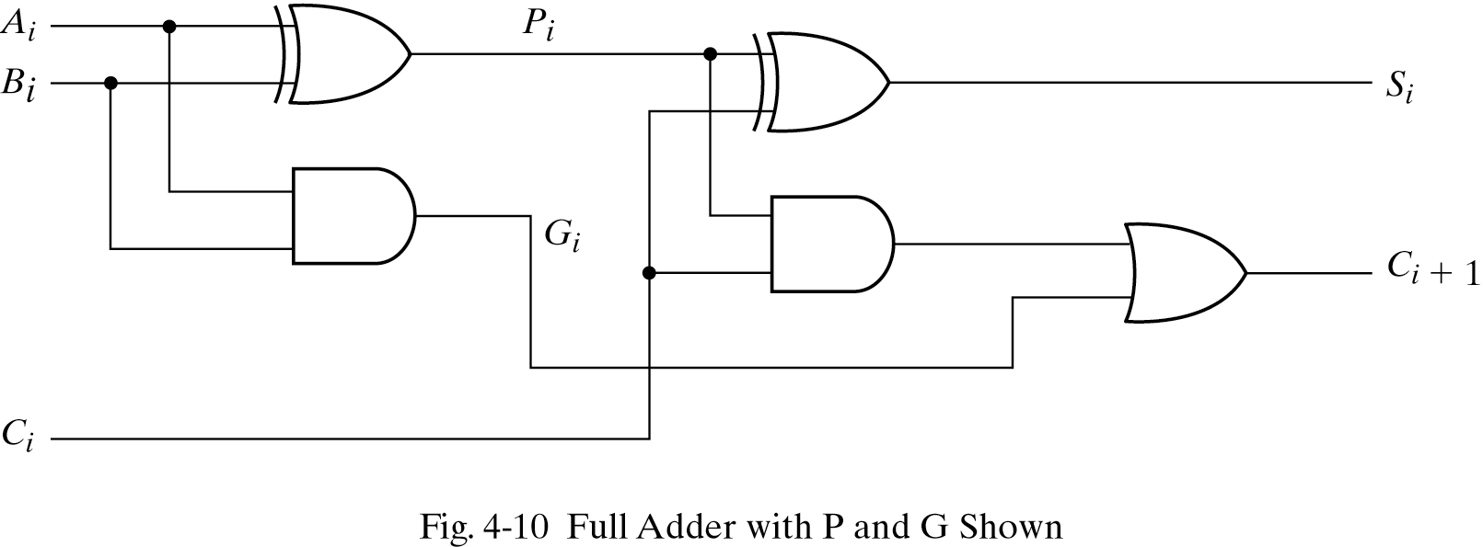
Carry Lookahead Logic
Carry Propagate P_{i} = A_{i} ⊕ B_{i}
Carry Generate G_{i} = A_{i} B_{i}
S_{i} = P_{i} ⊕ C_{i}
C_{i+1} = G_{i} + C_{i} P_{i}

Slide 61
Carry Lookahead Logic
All carries can be generated simultaneously
C₂ = G₁ + P₁C₁
C₃ = G₂ + P₂C₂ = G₂ + P₂G₁ + P₂P₁C₁
C₄ = G₃ + P₃C₃ = G₃ + P₃G₂ + P₃P₂G₁ + P₃ P₂P₁C₁

Slide 62
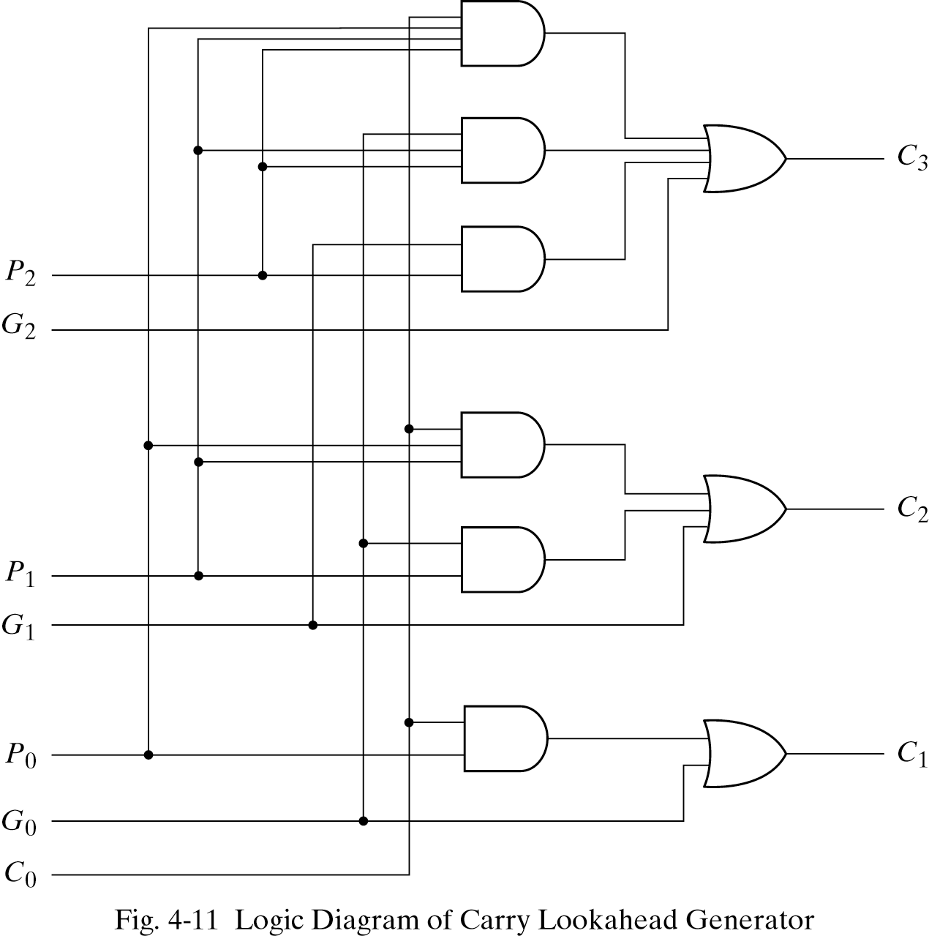
Carry Lookahead Logic

Slide 63
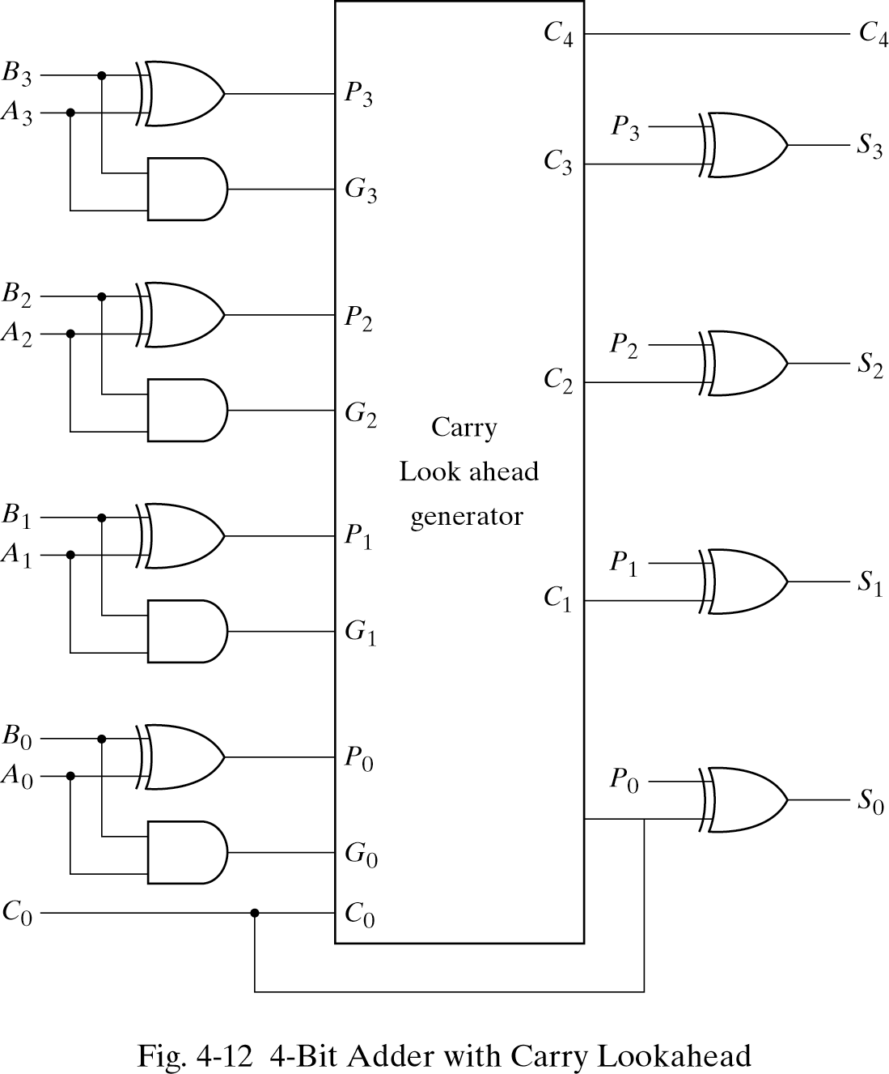
4-Bit Adder with Carry Lookahead

Slide 64
Binary Subtractor
Half Subtractor
Produces x -y
D – difference
D = x’y +xy’ = S of half adder
B = x’y
x
y
S
C
HS
x
- y
───
B D
x y | B D
0 0 | 0 0
0 1 | 1 1
1 0 | 0 1
1 1 | 0 0

Slide 65
Binary Adder
Full Subtractor
(x -y) –z; where z represents a borrow
x
y
z
D
B
FS
x y z | B D
0 0 0 | 0 0
0 0 1 | 1 1
0 1 0 | 1 1
0 1 1 | 1 0
1 0 0 | 0 1
1 0 1 | 0 0
1 1 0 | 0 0
1 1 1 | 1 1
 |  |  |  | y
 |  | 0 | 1 | 0 | 1
x |  | 1 | 0 | 1 | 0
 |  |  | z
D = xy'z'+x'yz'+x'y'z+xyz = x ⊕ y ⊕ z
 |  |  |  | y
 |  | 0 | 1 | 1 | 1
x |  | 0 | 0 | 1 | 0
 |  |  | z
B= x'y + x'z + yz

Slide 66
Binary Subtractor
Use 2’s complement with binary adder
x – y = x + (-y) = x + y’ + 1

Slide 67
Binary Adder/Subtractor
M: Control Signal (Mode)
M=0 ➔ F = x + y
M=1 ➔ F = x – y

Slide 68
Overflow
An overflow occurs when two number of n digits each are added and the sum occupies n+1 digits
When two unsigned numbers are added, an overflow is detected from the end carry out of the most significant position
When two signed numbers are added, the sign bit is treated as part of the number and the end carry does not indicate an overflow
Extra overflow detection circuits are required
An overflow can only occur when two numbers added are both positive or both negative

Slide 69
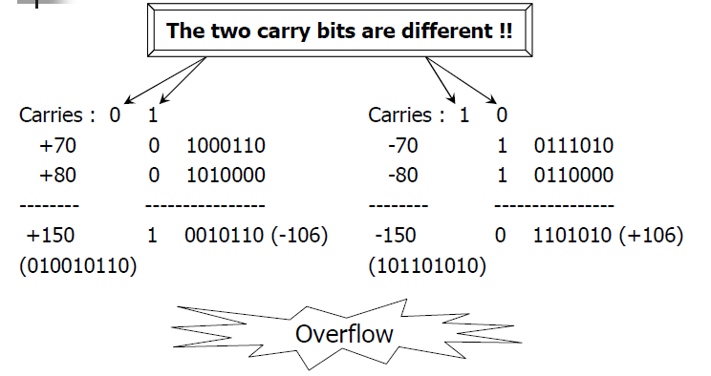
Overflow

Slide 70
Overflow
INPUTS |  |  | OUTPUTS
A_{sign} | B_{sign} | CARRY IN | CARRY OUT | SUM_{sign} | OVERFLOW
0 | 0 | 0 | 0 | 0 | 0
0 | 0 | 1 | 0 | 1 | 1
0 | 1 | 0 | 0 | 1 | 0
0 | 1 | 1 | 1 | 0 | 0
1 | 0 | 0 | 0 | 1 | 0
1 | 0 | 1 | 1 | 0 | 0
1 | 1 | 0 | 1 | 0 | 1
1 | 1 | 1 | 1 | 1 | 0

Slide 71
Overflow
x₃ x₂ x₁ x₀
y₃ y₂ y₁ y₀
Unsigned Binary Numbers
2’s Complement Numbers
0
FA
FA
FA
FA
Carry
C₄ C₃ C₂ C₁
S₃ S₂ S₁ S₀
x₃ x₂ x₁ x₀
y₃ y₂ y₁ y₀
0
FA
FA
FA
FA
Overflow
C₄ C₃ C₂ C₁
S₃ S₂ S₁ S₀

Slide 72
Decimal Adder
A decimal adder requires a minimum of 9 inputs
and 5 outputs
1 digit requires 4-bit
Input: 2 digits + 1-bit carry
Output: 1 digit + 1-bit carry
BCD adder
Perform the addition of two decimal digits in BCD, together with an input carry from a previous stage
The output sum cannot be greater than 19 (9+9+1)

Slide 73
BCD Adder
+ x₃ x₂ x₁ x₀
+ y₃ y₂ y₁ y₀
────────
Cy S₃ S₂ S₁ S₀
4-bits plus 4-bits
Operands and Result: 0 to 9
X +Y | x₃ x₂ x₁ x₀ | y₃ y₂ y₁ y₀ | Sum | Cy | S₃ S₂ S₁ S₀
0 + 0 | 0 0 0 0 | 0 0 0 0 | = 0 | 0 | 0 0 0 0
0 + 1 | 0 0 0 0 | 0 0 0 1 | = 1 | 0 | 0 0 0 1
0 + 2 | 0 0 0 0 | 0 0 1 0 | = 2 | 0 | 0 0 1 0
0 + 9 | 0 0 0 0 | 1 0 0 1 | = 9 | 0 | 1 0 0 1
1 + 0 | 0 0 0 1 | 0 0 0 0 | = 1 | 0 | 0 0 0 1
1 + 1 | 0 0 0 1 | 0 0 0 1 | = 2 | 0 | 0 0 1 0
1 + 8 | 0 0 0 1 | 1 0 0 0 | = 9 | 0 | 1 0 0 1
1 + 9 | 0 0 0 1 | 1 0 0 1 | = A | 0 | 1 0 1 0
Invalid Code
2 + 0 | 0 0 1 0 | 0 0 0 0 | = 2 | 0 | 0 0 1 0
9 + 9 | 1 0 0 1 | 1 0 0 1 | = 12 | 1 | 0 0 1 0
Wrong BCD Value
0001 1000

Slide 74
BCD Adder
X +Y | x₃ x₂ x₁ x₀ | y₃ y₂ y₁ y₀ | Sum | Cy | S₃ S₂ S₁ S₀ | Required BCD Output | Value
9 + 0 | 1 0 0 1 | 0 0 0 0 | = 9 | 0 | 1 0 0 1 | 0 0 0 0 1 0 0 1 | = 9
9 + 1 | 1 0 0 1 | 0 0 0 1 | = 10 | 0 | 1 0 1 0 | 0 0 0 1 0 0 0 0 | = 16
9 + 2 | 1 0 0 1 | 0 0 1 0 | = 11 | 0 | 1 0 1 1 | 0 0 0 1 0 0 0 1 | = 17
9 + 3 | 1 0 0 1 | 0 0 1 1 | = 12 | 0 | 1 1 0 0 | 0 0 0 1 0 0 1 0 | = 18
9 + 4 | 1 0 0 1 | 0 1 0 0 | = 13 | 0 | 1 1 0 1 | 0 0 0 1 0 0 1 1 | = 19
9 + 5 | 1 0 0 1 | 0 1 0 1 | = 14 | 0 | 1 1 1 0 | 0 0 0 1 0 1 0 0 | = 20
9 + 6 | 1 0 0 1 | 0 1 1 0 | = 15 | 0 | 1 1 1 1 | 0 0 0 1 0 1 0 1 | = 21
9 + 7 | 1 0 0 1 | 0 1 1 1 | = 16 | 1 | 0 0 0 0 | 0 0 0 1 0 1 1 0 | = 22
9 + 8 | 1 0 0 1 | 1 0 0 0 | = 17 | 1 | 0 0 0 1 | 0 0 0 1 0 1 1 1 | = 23
9 + 9 | 1 0 0 1 | 1 0 0 1 | = 18 | 1 | 0 0 1 0 | 0 0 0 1 1 0 0 0 | = 24
✗
✗
✗
✗
✗
✗
✗
✗
✗
+ 6

Slide 75
BCD Adder
Correct Binary Adder’s Output (+6)
If the result is between ‘A’ and ‘F’
If Cy = 1
S₃ S₂ S₁ S₀ | Err
0 0 0 0 | 0
1 0 0 0 | 0
1 0 0 1 | 0
1 0 1 0 | 1
1 0 1 1 | 1
1 1 0 0 | 1
1 1 0 1 | 1
1 1 1 0 | 1
1 1 1 1 | 1
 |  |  |  | S₁
 |  |  |  |  |  | S₂
S₃ |  | 1 | 1 | 1 | 1
 |  |  |  | 1 | 1
 |  |  | S₀
Err = S₃ S₂ + S₃ S₁

Slide 76
BCD Adder
Err

Slide 77
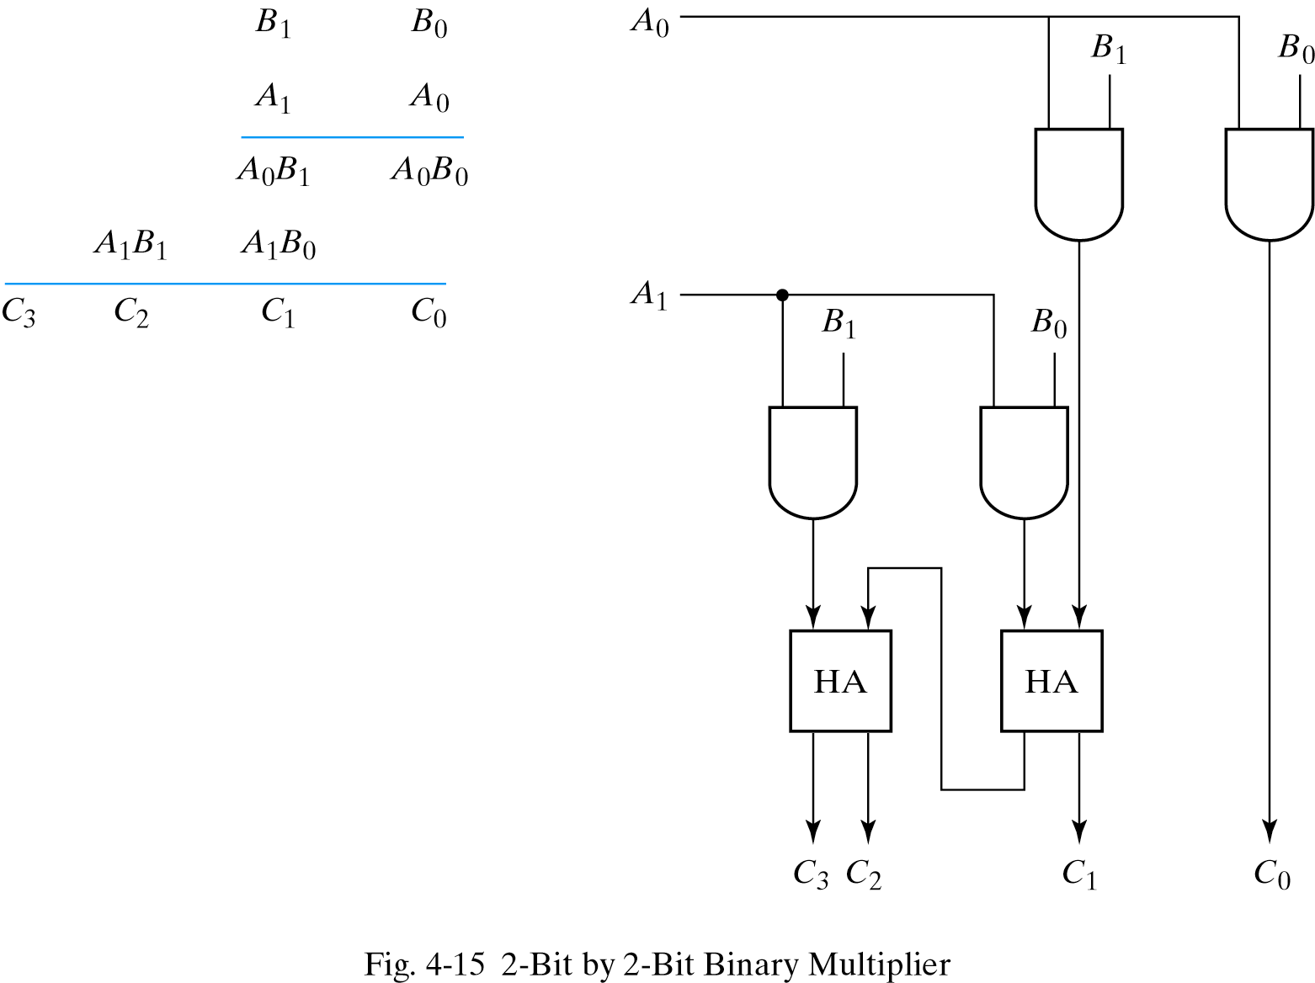
Binary Multipilier

Slide 78
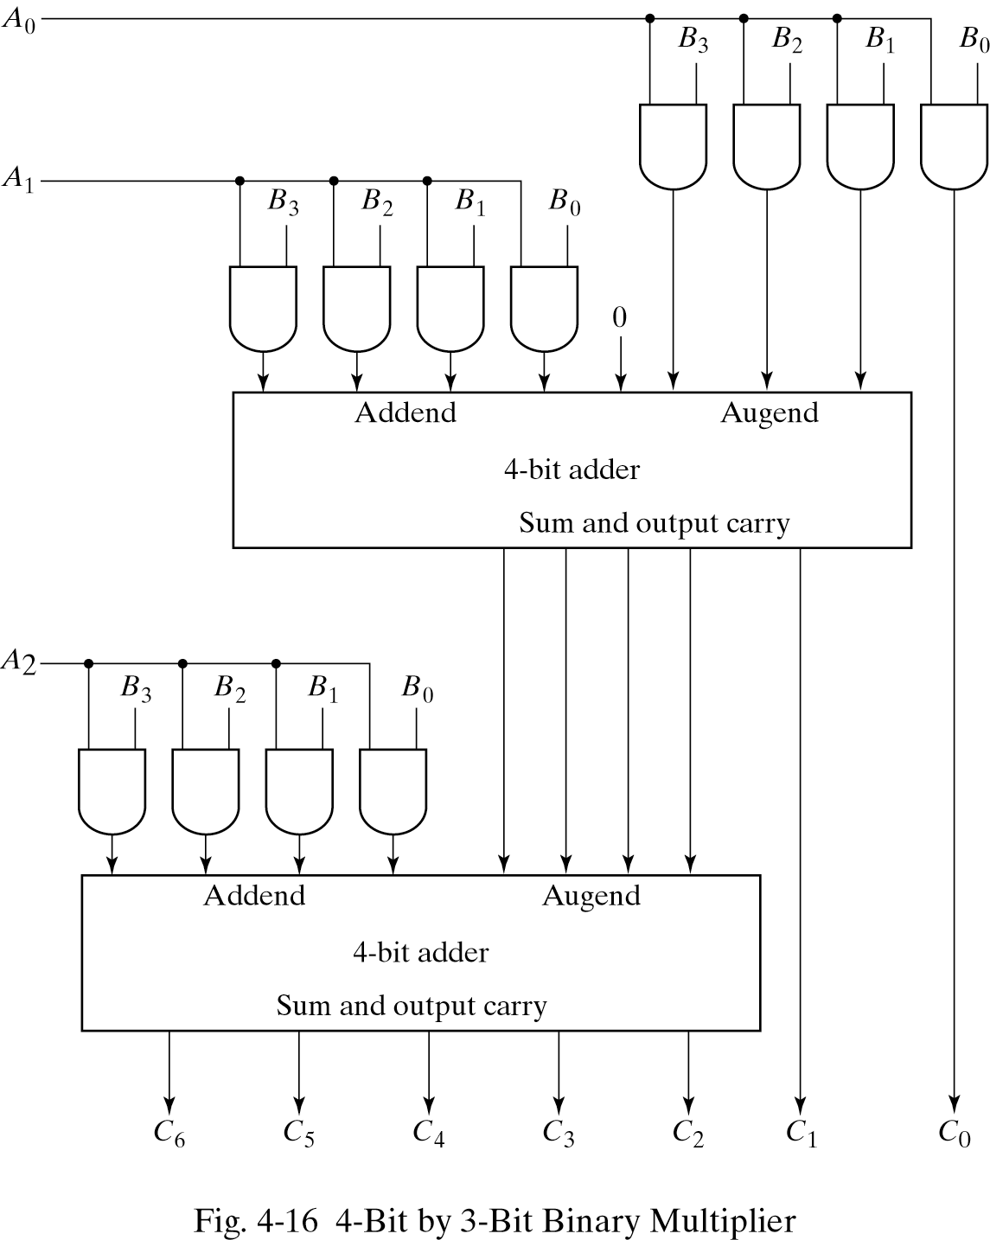
Binary Multipilier

Slide 79
Magnitude Comparator
Compare 4-bit number to 4-bit number
3 Outputs: < , = , >
Expandable to more number of bits
A₃A₂A₁A₀ B₃B₂B₁B₀
Magnitude Comparator
A<B A=B A>B

Slide 80
Magnitude Comparator

Slide 81
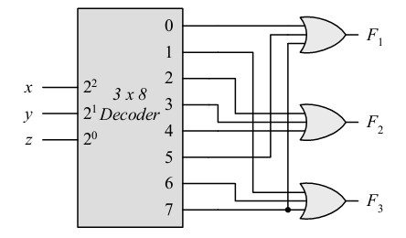
Practice
Using a decoder and external gates, design the combinational circuit defined by the following three boolean functions:
F₁ = x’ y’z’ + xz = ∑ (0, 5, 7)
F₂ = xy’z’ + x’y = ∑ (2, 3, 4)
F₃ = x’y’z + xy = ∑ (1, 6, 7)

Slide 82
Practice
A combinational circuit is specified by the following three boolean functions:
F₁ (A, B, C) = ∑ (3, 5, 6)
F₂ (A, B, C) = ∑ (1, 4)
F₃ (A, B, C) = ∑ (2, 3, 5, 6, 7)
Implement the circuit with a decoder constructed with NAND gates.

Slide 83
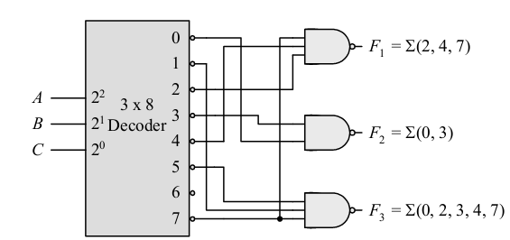
Practice

Slide 84
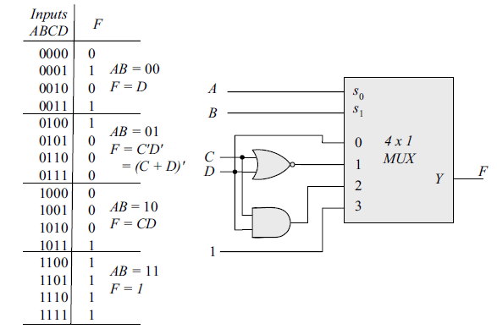
Practice
Implement the following Boole an function with a 4 X 1 multiplexer and external gates.
F(A, B, C, D) = ∑ (1, 3, 4, 11, 12, 1 3, 14, 15)

Slide 85
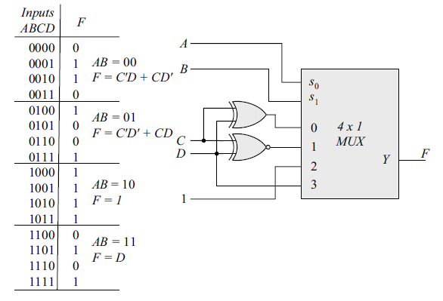
Practice
Implement the following Boole an function with a 4 X 1 multiplexer and external gates.
F(A, B, C, D) = ∑ (1, 2, 4, 7, 8, 9, 10, 11, 13, 15)

Slide 86
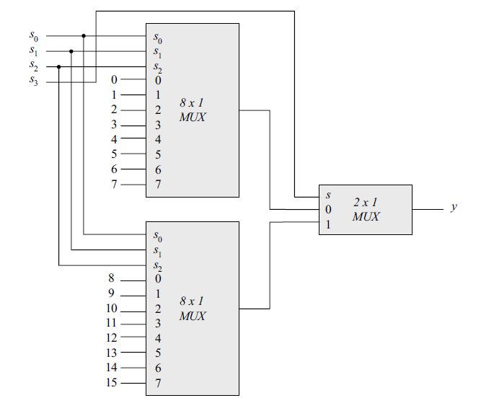
Practice
Construct a 16 X 1 multiplexer with two 8 X 1 and one 2 X 1 multiplexers. Use block diagrams

Slide 87
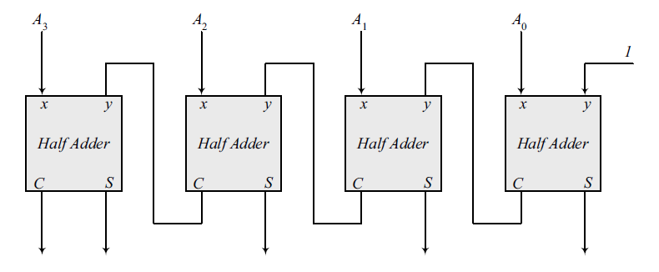
Practice
Using four half-adders design a 4-bit combinational circuit incrementer (a circuit that adds 1 to a 4-bit binary number)

Slide 88
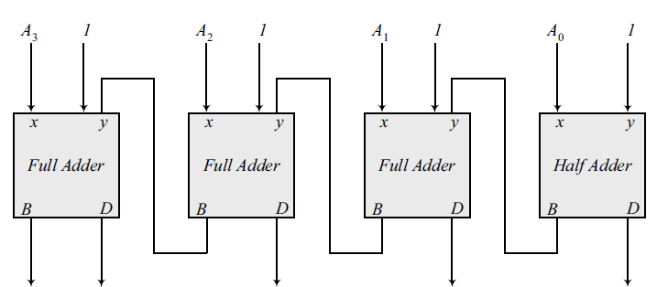
Practice
Using a half-adder and three full-adeders design a 4-bit combinational circuit decrementer (a circuit that subtracts 1 from a 4-bit binary number)

Slide 89
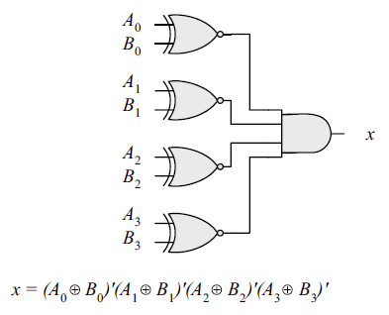
Practice
Design a combinational circuit that compares two 4-bit numbers to check if they are equal. The circuit output is equal to 1 if two numbers are equal and 0 otherwise.

